Slide 1

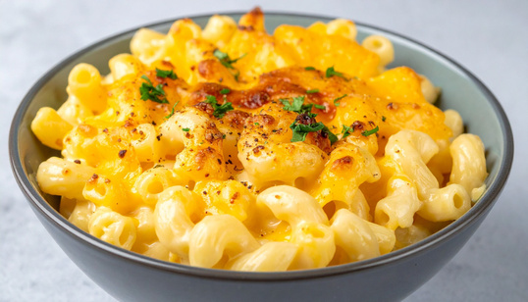

Ingredients
175g dried macaroni or any suitable dried pasta
For the cheese sauce:
25g margarine
25g plain flour
150ml milk
100g Cheddar cheese
For the topping: 15g grated cheddar cheese
Macaroni & Cheese
Method
1. Turn the oven on 180C / gas mark 4.
2. Fill a pan half full with water and put onto boil.
3. Add the macaroni to the boiling water and cook for the time recommended on its packet.
4. Grate the all of the cheddar cheese, keep 25g a side.
5. To make the sauce, put your margarine, plain flour and milk in another pan. Bring to the boil, stirring constantly with a wooden spoon, until it thickens.
6. Remove the thickened sauce from the heat. Mix in the grated Cheddar cheese and mustard.
7. Using a colander over the sink drain the cooked macaroni.
8. Add the drained macaroni to the cheese sauce and stir.
9. Pour into the ovenproof dish. Grate the 25g of Cheddar cheese. Sprinkle on top.
10. Bake in the oven for 15 minutes or until the top is golden brown.
Cooking Date: ______________________________

Slide 2
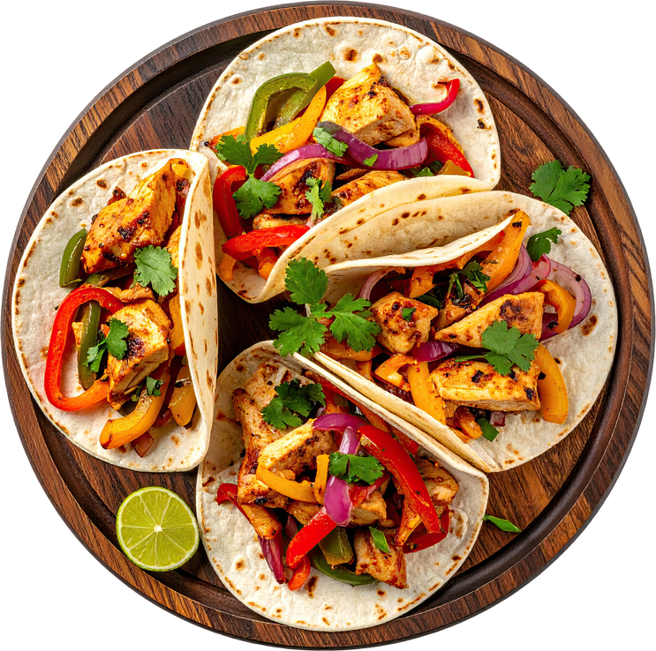
Ingredients
2 Chicken breasts
1 clove of garlic
1 small pepper (any colour)
1 small onion
1 tomato(optional)
25g of grated cheese
2 tortilla wraps
Fajita Seasoning (supplied by the school)
Guacamole or Salsa (Optional)
Please bring a suitable container with lid
Chicken Fajitas
Method
1. Peel and chop the onion, and garlic.
2. Slice the peppers into strips.
3. Chop the tomato (if using) and grate the cheese.
4. Chop the chicken and cut it into strips and mix the chicken in the marinade.
5. Add the marinated chicken to the wok or frying pan and stir-fry for about 4 minutes. Check that the chicken is cooked.
6.Add the onion and green pepper and continue to cook for a further 2 minutes.
7. Spread a little chicken in the centre of the tortilla, add some tomato, cheese and guacamole, then roll up.
Cooking Date: ______________________________

Slide 3

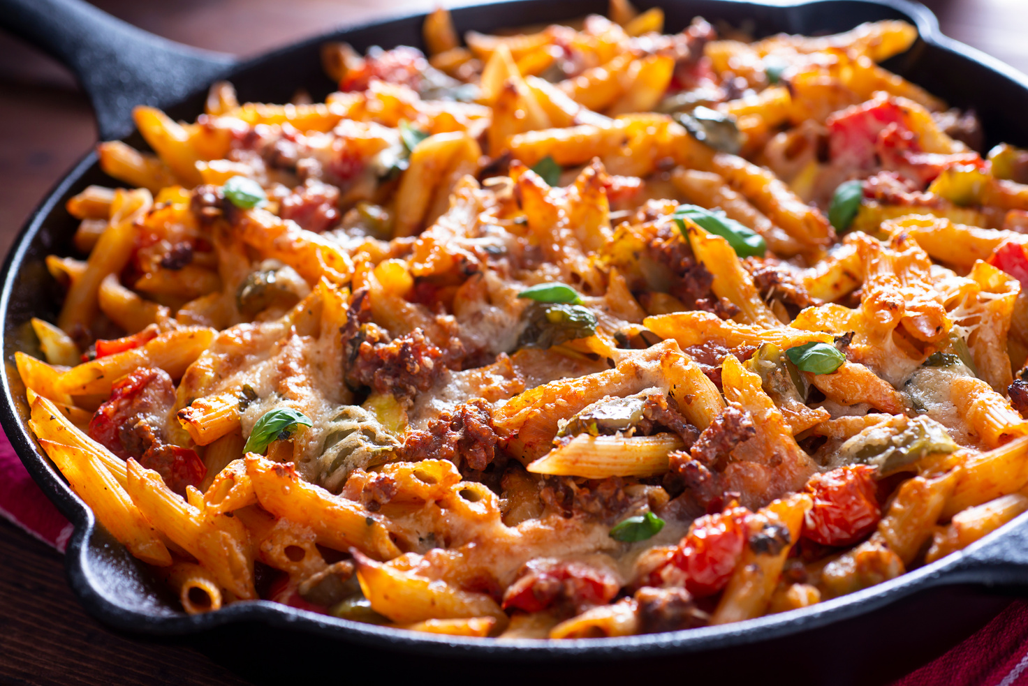
Ingredients
1 to 2 chicken breast(s)
1 onion
1 pepper of any colour
1 garlic clove
1 tsp grated or finely chopped ginger
A small tin of pineapple chunks, reserving 100ml of the juice for the sauce
(All sauce ingredients will be provided by the school)
3 tbsp tomato puree
2 tbsp vinegar
1 tbsp of brown sugar
1 tbsp soy sauce
1 Teaspoon of corn flour
Sweet &
Sour Chicken
Method
1. Finely dice your onion, peel your garlic and ginger and crush your garlic and chop both finely.
2. Heat a wok or frying pan over a high heat until very hot. Add 1 tbsp of the oil, swirl around the pan, then add the diced onion, after 2 minutes add the chopped garlic and ginger.
3. After 5 minutes of cooking add the chicken, cook the chicken until it looks golden brown and is cooked through.
4. Add the peppers and cook for 5 mins or until softened. Season with a pinch of salt, pepper and mixed herbs.
5. Add the pineapple chunks to the pan. Pour over the sauce and leave to bubble for a couple of mins, stirring often, until cooked through.
Cooking Date: ______________________________

Slide 4
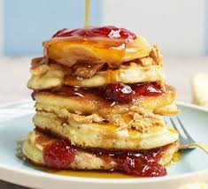

Ingredients
135g self-raising flour
pinch of salt
1 tbsp sugar
150ml milk
1 egg, lightly beaten
Oil for cooking (provided by school)
Optional flavourings: 50g chopped strawberries, blueberries or dried fruit
American
Pancakes
Method
1. Put the flour, salt and caster sugar into a bowl.
2. Lightly mix the egg and milk in a jug.
3. Gradually add the milk mixture to the flour until you get a smooth batter.
4.Sir the flavouring into the batter.
5. Heat a small amount of oil in a frying pan over a medium heat. Pour in a tablespoon of batter to form a circle.
6. When the top of the pancake begins to bubble, turn it over and cook until both sides are golden brown and the pancake has risen.
7. Repeat until all of the batter is used up. Remember to regulate the heat.
Cooking Date: ______________________________

Slide 5
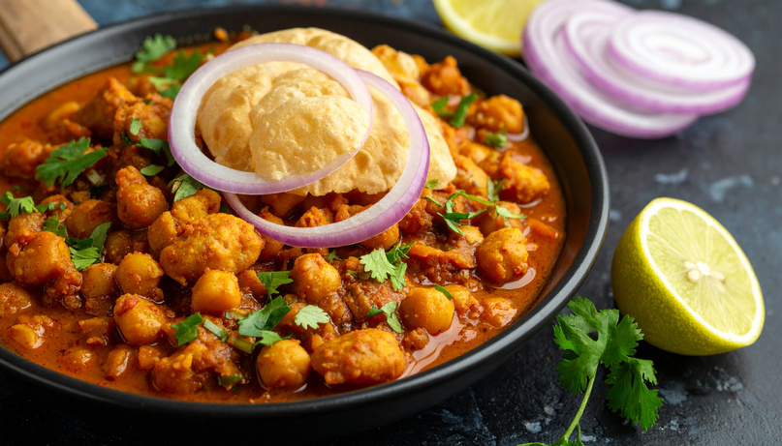
Ingredients
1 chicken breast or 3 chicken thighs
1 small onion
1 clove of garlic
school will provide the below ingredients
2 tablespoons of curry powder
2 tablespoons of spinach
2 tablespoons of chickpeas
1 tablespoon of chopped tomatoes
Please bring a suitable container with lid
Chicken Curry
Method
1. Chop up the onions and chop the garlic separately from the onions.
2. Use a red chopping board to chop the chicken into bite-sized chunks
3. Add 1 tablespoon of oil to a pan and heat it on number 3 for 1 minute.
4. Add the onion to the oil and cook for one minute, add the chopped garlic, and cook both ingredients until the onion is clear in colour and has started to, turn brown.
5. Add the chicken to the cooked onion and garlic. Cook the chicken until it has turned white.
6 .Add the curry paste and cook for 1 minute, add the chopped tomatoes and cook further for one minute.
7.Add the chickpeas and season with salt, pepper, and chili powder.
8. Add the spinach and cook for another minute then take the pan off the heat.
Cooking Date: ______________________________

Slide 6
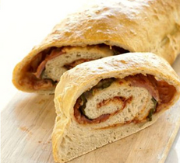
Ingredients
Bread dough:
150g strong flour
1 ½ tsp yeast
¼ tsp salt
80ml warm water
1 tbsp. oil
Yummy Bread
Method
1. Put flour into the bowl. Add 2 tsp yeast, then add 1 tsp salt and mix the ingredients together
3. Measure 80ml warm water and add to the dry ingredients.
4. Stir with the palette knife and then use your hands to bring together into a dough. Knead for 10 mins
6. Prepare fillings
7. Roll out the dough, spread fillings over and roll up, sealing the edges
8. Use the fork to press down the length. Glaze with oil and salt
9. Bake for 20 mins, until risen, firm and golden brown.
Cooking Date: ______________________________

Slide 7
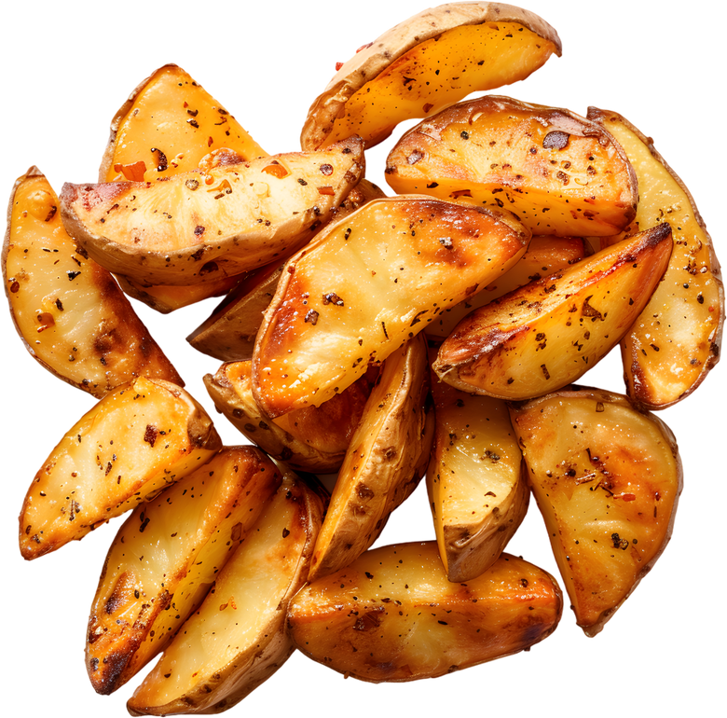

Ingredients
2 chicken breasts or 2 chicken legs
Suitable marinade of your choice
2 potatoes or 2 sweet potatoes
15ml oil (Provided by school)
1 tbsp of paprika (Provided by school)
Nandos Chicken & Wedges
Method
1. Butterfly your chicken
2. Add the chicken to a mixing bowl and cover with marinated- leave for as long as needed.
3. Peel and cut the potatoes into strips.
2. Cover potatoes in oil and paprika
3. Cook the potatoes in the oven for 20mins
4. Add the chicken to a baking tray and cook for 15mins
5. Check the temperature of the chicken and serve.
Cooking Date: ______________________________

Slide 8
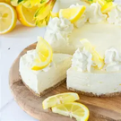
Ingredients
12 suitable biscuits (digestives / ginger nut biscuits /Oreo Cookies)
2 tablespoons of Butter or margarine
120g tub of Cream Cheese (200g) (not light)
1 lemon (Optional)
1 ½ tablespoons of sugar
1 small carton of double or whipping Cream (not single cream)
Optional: strawberries/ berries/ raspberries to decorate
Please bring a suitable flan container with lid
Chilled
Lemon Flan
Method
1. Melt margarine in a pan
2. Crush digestives using a bowl and rolling pin.
3. Mix butter with biscuits thoroughly
4. Press into your dish evenly
5. Whisk cream cheese and cream in a bowl until stiff.
6. Add grated lemon rind and some lemon juice.
7. Fold in sugar gently
8. Place on top of the biscuit base
9. Decorate
10. Place in fridge and leave top set
Cooking Date: ______________________________

Slide 9
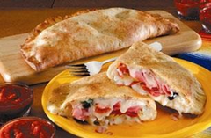
Ingredients
250g Strong plain white or brown bread flour
7g (1 Sachet) Yeast (supplied by school)
2 Tablespoons Olive Oil (supplied by school)
½ teaspoon Salt (supplied by school)
½ teaspoon Sugar (supplied by school)
Filling Ingredients:
1 small jar of passata / tomato pizza sauce / or sauce of your choice (do not use tomato purée or ketchup)
75g cheese:
Any meat of your choice
Any vegetables / fruit of your choice
Herbs (supplied by school)
Calzone Pizza
Method
1.Weigh all dry ingredients and stir together in a bowl. add your oil
2.Gradually add the warm water (from the tap).
3.Knead the dough onto a lightly floured clean surface for 10 minutes, it should become stretchy and smooth.
4.Divide your dough into 2 portions and roll each one out on a floured surface to form a circle
5.Spoon the filling on to one half of each circle and top with your cheese.
6.Fold the dough over to enhance the filling sealing the edge with a fork
7.Glaze with beaten egg and put on a greased baking tray and cook for 25-30 minutes on gas mar 7/ 220 degrees or until risen and golden brown.
Cooking Date: ______________________________

Slide 10
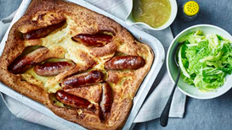
Ingredients
4 sausages
For the batter
70g plain flour
pinch of salt
2eggs
150ml semi-skimmed milk
Toad in the Hole
Method
1. Heat oven to 220C/200C fan/gas 7.
2. Make up the batter mix. Tip the flour into a bowl with the salt, make a well in the middle and crack both eggs into it. Use a balloon whisk to mix it together, then slowly add the milk, whisking all the time. Set aside for at least 30 minutes, preferably overnight.
3. Put the sausages in a 20 x 30cm roasting tin with the oil, then bake for 15 minutes until browned.
4. Carefully remove the sausages from the oven – be careful because the fat will be sizzling hot.
5. Pour in the batter mix, transfer to the top shelf of the oven, then cook for 25-30 minutes, until risen and golden.
Cooking Date: ______________________________

Slide 11
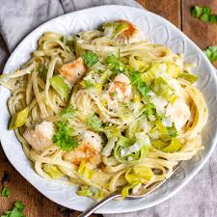
Ingredients
½ a packet of dried Spaghetti
2 Chicken breasts or 4 chicken thighs
2 cloves of garlic
2 single leeks
1 tablespoon of cream cheese (provided by the school)
1 small packet of mushrooms (Optional)
Salt (provided by the school)
Pepper (provided by the school)
Mixed herbs (provided by the school)
Please bring a suitable container with lid
Chicken & Leek
Spaghetti
Method
1. Boil the spaghetti in half a pan filled with hot water
2. Whilst the spaghetti is boiling, chop up the leeks and mushrooms, wash them, leave to drain in a colander.
3. Add a tablespoon of oil to a pan and heat the oil on number three heat. Keep an eye on the oil.
4. Peel and finely chop the garlic.
5. Chop the chicken into bite sized chunks.
7. Drain the Spaghetti in a colander keep some of the water (150ml) for the sauce!
8. Add the chicken to the hot oil, when the chicken has turned white add the Leeks, after two minutes add the garlic and mushrooms (if using).
9. Add the cream cheese to the chicken and Leek. Add the drained spaghetti, and 150 ml of the water from the Spaghetti to the Chicken and Leek. Season with salt, pepper and mixed herbs.
10. Leave to simmer for five minutes and add the dish to your lidded container.
Cooking Date: ______________________________

Slide 12
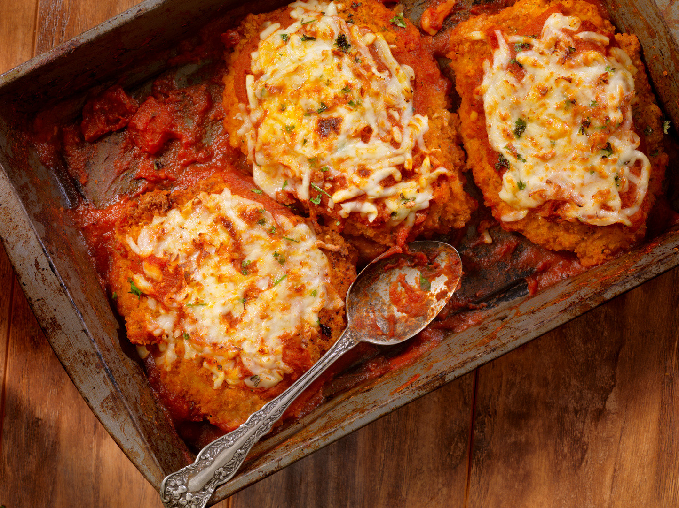
Ingredients
1 large chicken breast
1 tablespoon of butter or margarine
1 egg
100g of either grated cheddar/mozzarella or parmesan cheese
75g breadcrumbs (the school will provide this item)
1 garlic clove
350ml passata
1 teaspoon sugar
1 tablespoon oil (the school will provide this item)
1 teaspoon dried oregano (the school will provide this item)
Chicken
Parmigiana
Method
1. Preheat oven to gas mark 6/electric 170, Place butter in the baking dish and put it into the oven
2. Halve the chicken breast through the middle and place it between 2 sheets of cling film.
3.. Bash with a rolling pin until it is the thickness of a £1 coin
4.. Break the egg into a bowl
5.. Place the breadcrumbs into a bowl and mix with the cheese
6. Dip the chicken in the egg and then the crumb and repeat
7. Take the baking dish out of the oven and coat the chicken with the melted butter – place this in the oven for 15 minutes
8. Heat the oil and cook the garlic for 1 minute, add the passata, sugar, and oregano, season, and simmer for 10 minutes
10. Turn the chicken over, pour the tomato sauce over this, sprinkle cheese, and cook for another 10 minutes.
Cooking Date: ______________________________

