Slide 1
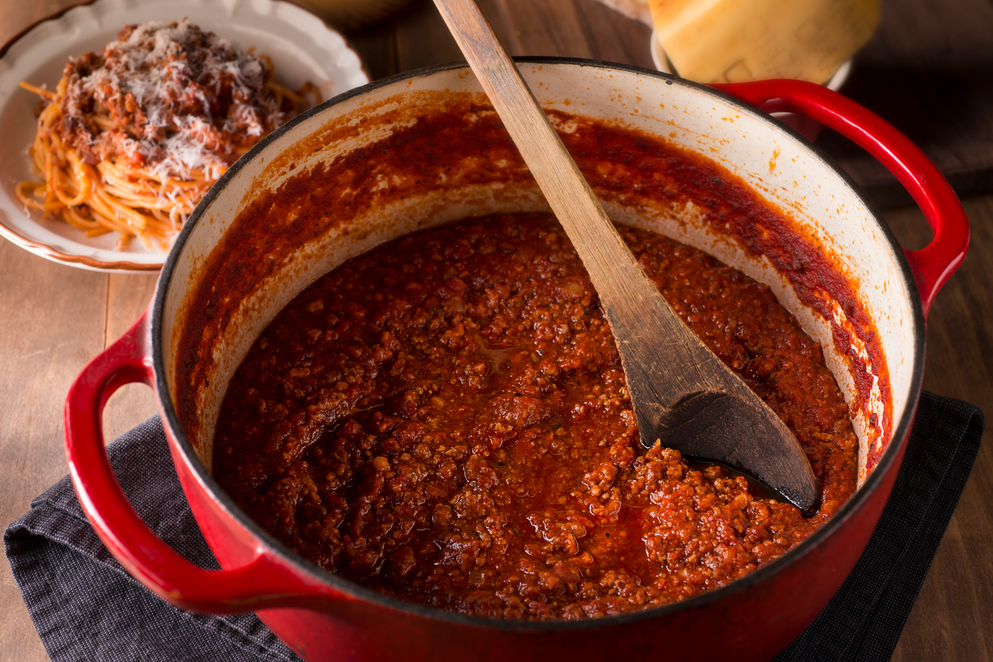


Ingredients
  250g packet of lean minced beef OR meat alternative
  1 onion
  1 can of chopped tomatoes
  1 Stock cube(optional)
  1 Pepper of any colour
  Herbs (Provided by school)
Equipment
  Pan
  Chopping board
  Sharp knife
  Wooden spoon
Please bring a suitable container with lid
Bolognese Sauce
Method
  1. Peel and chop the onion, garlic, and other vegetables.
  2. Add 1 tablespoon of oil to a pan and heat up (Do not allow this to get too hot!).
  3. Add the onions to the oil, after one minute adds the chopped garlic,
  4. When the onions start to go see through add the chopped vegetables and cook for five minutes.
  5. Add the meat, and fry until it turns brown.
  6. Add the canned tomatoes to the pan.
  7. Add a teaspoon of salt/pepper/herbs for flavour
  8. Stir with a wooden spoon. Simmer for 15 minutes.
Cooking Date: ______________________________

Slide 2
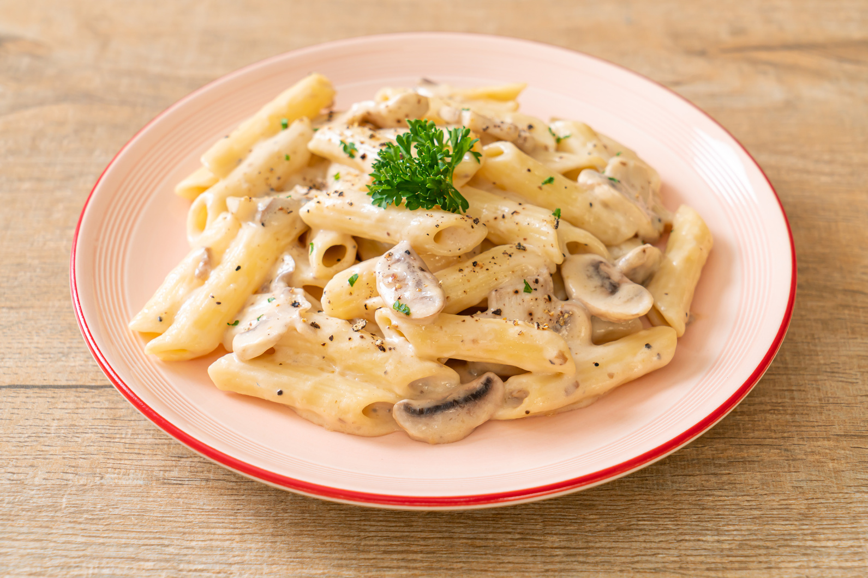
Ingredients
  150g pasta
  2 slices bacon, rind removed or 1 cooked Chicken breast or 2 slices of Ham.
  50g mushrooms or frozen peas or sweetcorn
  1 small onion
  ½ tbsp vegetable oil (Provided by school)
  50ml crème fraiche or natural yogurt (Provided by school)
Please bring a large plastic container to take home
Storage: Keep refrigerated and eat within one day
Preparation: Reheat thoroughly until piping hot
Creamy Pasta
Method
  1. Put a large pan of water on to boil and cook the pasta according to the packet instructions and then drain.
  2. Peel and chop the onion and other vegetables.
  3. Heat the oil in the pan and gently fry the onion for 2 minutes. Add the bacon and fry until the onions are soft and the bacon is cooked.
  3. Add the other vegetables and gently fry for another 2 minutes.
  4. Stir in the cooked pasta then remove from the heat.
  5. Add the crème fraiche or yogurt and the optional ingredients. Make sure the pasta is evenly coated.
  6. Serve immediately garnished with parsley.
Cooking Date: ______________________________

Slide 3
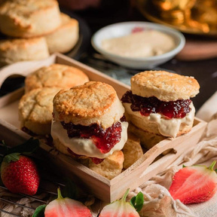
Ingredients
  250g self-raising flour
  40g butter or margarine
  25g of raisins/glace cherries/sultanas
  25g sugar
  125ml semi-skimmed milk
Scones
Method
  1. Preheat oven to 220°C or gas mark 7.
  2. Grease or line the baking tray.
  3. Sift the flour into the bowl.
  4. Rub the fat into the flour until it resembles breadcrumbs.
  5. Stir in the sugar and fruit.
  6. Make a well in the middle of the flour and carefully pour in the milk. (Save just a little of the milk to glaze the top of the scones before they bake).
  7. Mix to form a soft dough.
  8. Place the dough on a lightly floured work surface.
  9. Roll out the dough to about 1½cm thick.
  10. Shape the scones using a cutter.
  11. Place the scones on a baking tray and brush each top with a little milk.
  12. Bake for 12 – 15 minutes, until golden brown.
  13. Allow to cool on a cooling rack.
Cooking Date: ______________________________

Slide 4
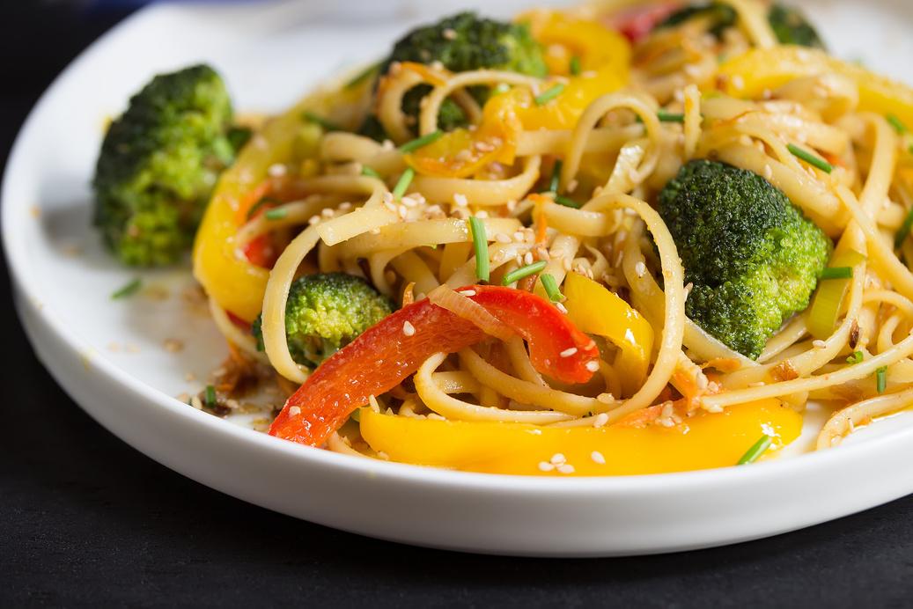
Ingredients
1 small onion
½ cabbage
1 pepper of any colour
100g of mushrooms
½ packet of noodles
The ingredients for the Sauce will be available in school (soy sauce, ginger puree, chili flakes and brown sugar)
Please bring a suitable container with lid
Vegetable Stir Fry
Method
1. Wash all vegetables and allow to drain in a sieve.
2. Chop up all the vegetables.
3. Add 1 tablespoon of oil to a wok, allow it to heat up.
4. Boil ¾ of a pan of hot tap water on the hob.
5.Add all the vegetables to the wok and stir fry for 7 minutes.
6. Add the noodles to the pan of boiling water and cook the noodles for five minutes.
7. Drain the noodles in the sink.
8. Whilst the noodles are drained make the sauce by adding soy sauce, ginger puree, chilli flakes and brown sugar to a jug, add a little corn flour to thicken.
9. Add the boiled noodles to the str fried vegetables, add the sauce & mix..
Cooking Date: ______________________________

Slide 5
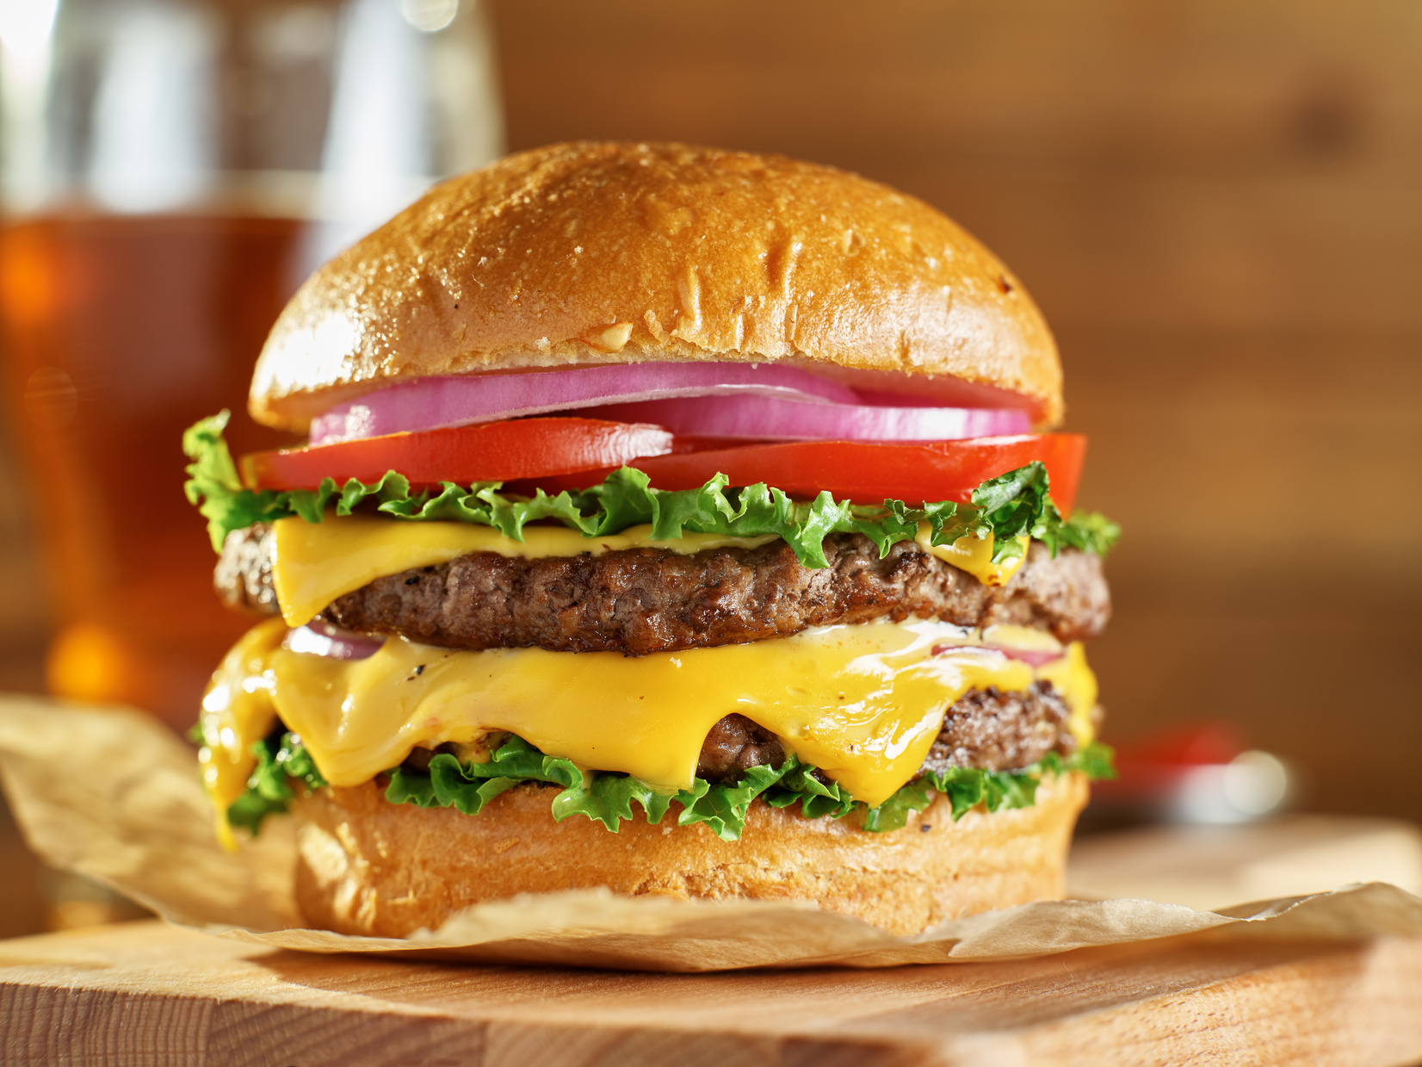
Ingredients
  150g beef mince (10 to 15% fat)
  1 egg (the school will provide eggs)
  1 teaspoon of mixed herbs, ½ teaspoon of salt, ½ a teaspoon of pepper (the school will provide this item)
  10g of breadcrumbs (the school will provide this item)
  2 burger buns
Accompaniments
Optional choose the ingredients you prefer; lettuce/ tomato/ ketchup/ slices of cheese/ mustard/ relish
Burgers
Method
  1. Add the mince to a large mixing bowl
  2. Beat egg in a small bowl and add half to the meat
  3. Make breadcrumbs using a blender
  4. Add the breadcrumbs and the flavourings to the meat
  5. Mix the ingredients thoroughly
  6. Shape the burgers into two separate burgers.
  7. Add 1 teaspoon of oil to a frying pan and cook your burgers, turn with a fish slice when one side is brown on the outside, and turn the burgers around until they are brown on the inside.
  8. Construct your burger with your toppings of choice.
Cooking Date: ______________________________

Slide 6
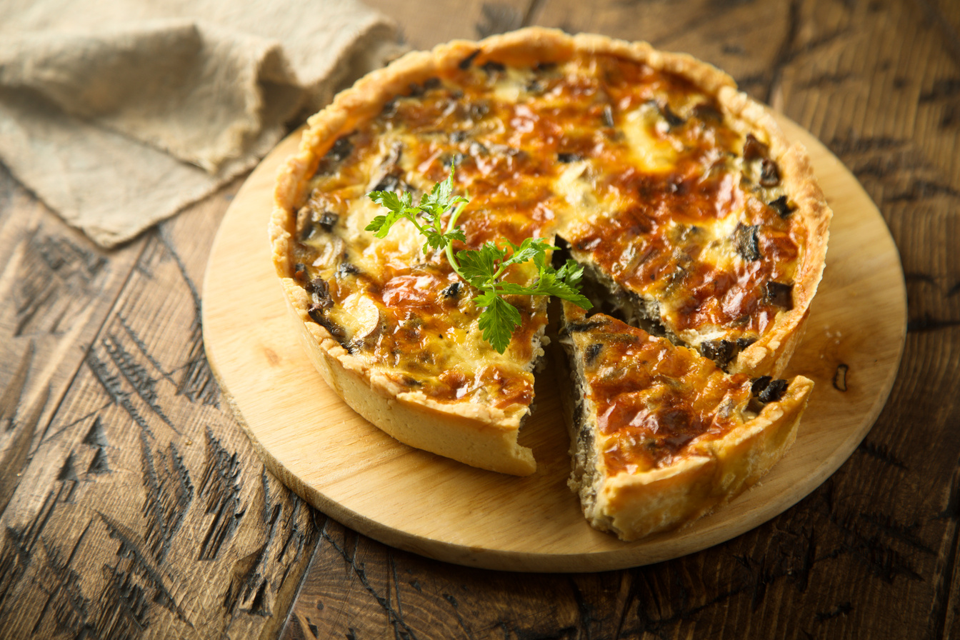
Ingredients
150g plain flour
75g butter or margarine (block & cold)
2-3 tablespoons cold water
100g bacon (optional) cooked & chopped.
1 tomato (Optional)
100g grated cheese.
2 eggs
125ml milk
Salt and pepper (provided by school)
Quiche
  1. Put the flour into mixing bowl.
  2. Cut the butter into very small pieces and add to the flour.
  3. Rub the butter into the flour using your fingertips until the mixture looks like breadcrumbs.
  4. Sprinkle 2 tablespoons of water over the flour mixture and mix with a palette knife. Add sufficient water to make a firm smooth dough.
  5. Wrap up in cling film and leave in the fridge for 20 minutes to relax.
  6. Roll out pastry to 0.5cm thick.
  7. Lightly grease flan dish and line with pastry
  8. Put grated cheese into pastry case leaving some for the top.
  9. Cover with bacon pieces
  10. Beat the eggs and milk together and season with salt and pepper.
  11. Sprinkle remaining cheese over top & Bake for 20mins.
Method
Cooking Date: ______________________________

Slide 7
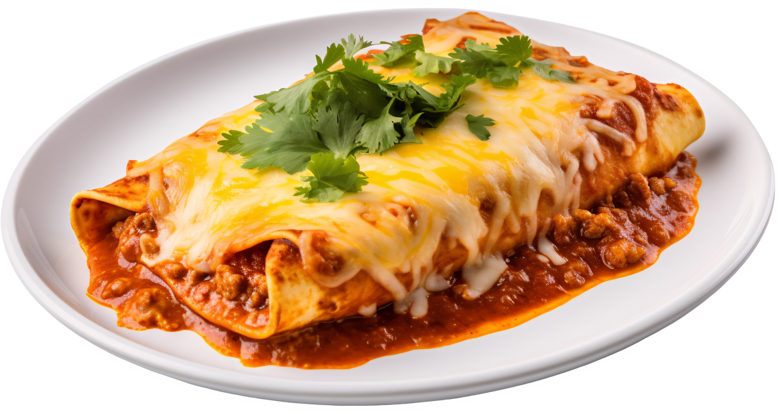
Ingredients
  100g of minced beef
  1 small onion
  1 stalk of celery (optional)
  1 clove of garlic
  1 red chilli
  1 beef stock cube
  1 tablespoon of red kidney beans (provided by the school)
  1 tin chopped tomatoes
Beef Enchiladas
Method
1. Finely chop the onion, garlic, chilli, and celery
2. Heat the oil in a wide frying pan. Add the beef and stir-fry over the heat for 4–5 minutes, breaking up it with a wooden spoon so it doesn’t form clumps and browns well.
3. Add the all vegetables and stir-fry for 3–4 mins
4. Add the stock cube and add the chilli paste, kidney beans and tomatoes. Bring to a boil and reduce the heat for 10 minutes, until thickened, stirring from time to time.
5.Preheat the oven to 220C/200C Fan/Gas 7. Lightly oil a shallow ovenproof dish (approximately 20x30cm/8x10in).
6. To assemble, lay the tortillas on a clean work surface and divide the beef mixture down the centre of each one, then roll up to seal. Place the stuffed tortillas carefully in the prepared dish, seam-side down, to fit snugly.
7. Scatter over the jalapeños and then the cheese. Cover the dish with foil and bake for 10 minutes, then remove the foil and bake for another 10 minutes, or until lightly golden and bubbling. Sprinkle coriander on top.
Cooking Date: ______________________________

Slide 8
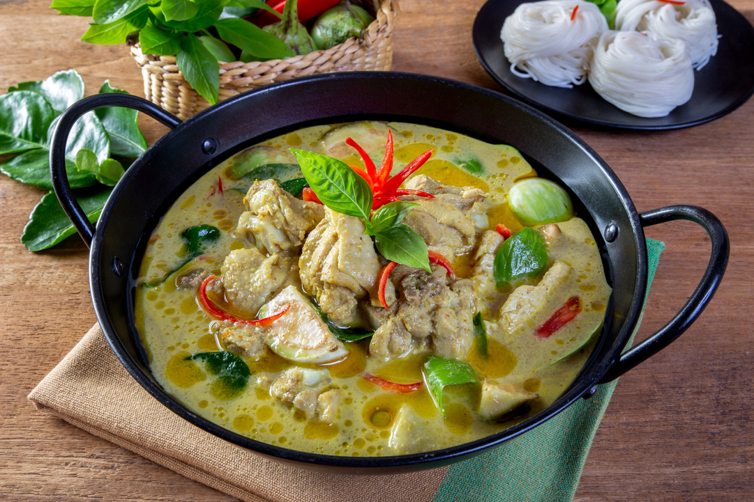
Ingredients
  1 small onion
  1 clove of garlic
  1 small chicken breast
  1 small green pepper
  2 x 15ml Thai green curry paste (will be provided by the school)
  200ml coconut milk (reduced fat; will be provided by the school)
Please bring in a suitable container with a lid.
Thai Green Curry
Method
  1. Prepare the vegetables: slice the onions; crush and chop the garlic.
  2. Cut the chicken into small chunks.
  3. Fry the onion, garlic, and chicken in the oil for 3-4 minutes.
  4. When the chicken has turned ‘white’, stir in the green curry paste, followed by the chopped green pepper.
  5. Pour in the coconut milk and simmer for 15 minutes.
  6. Squeeze the lime and pour over the curry.
Cooking Date: ______________________________

Slide 9
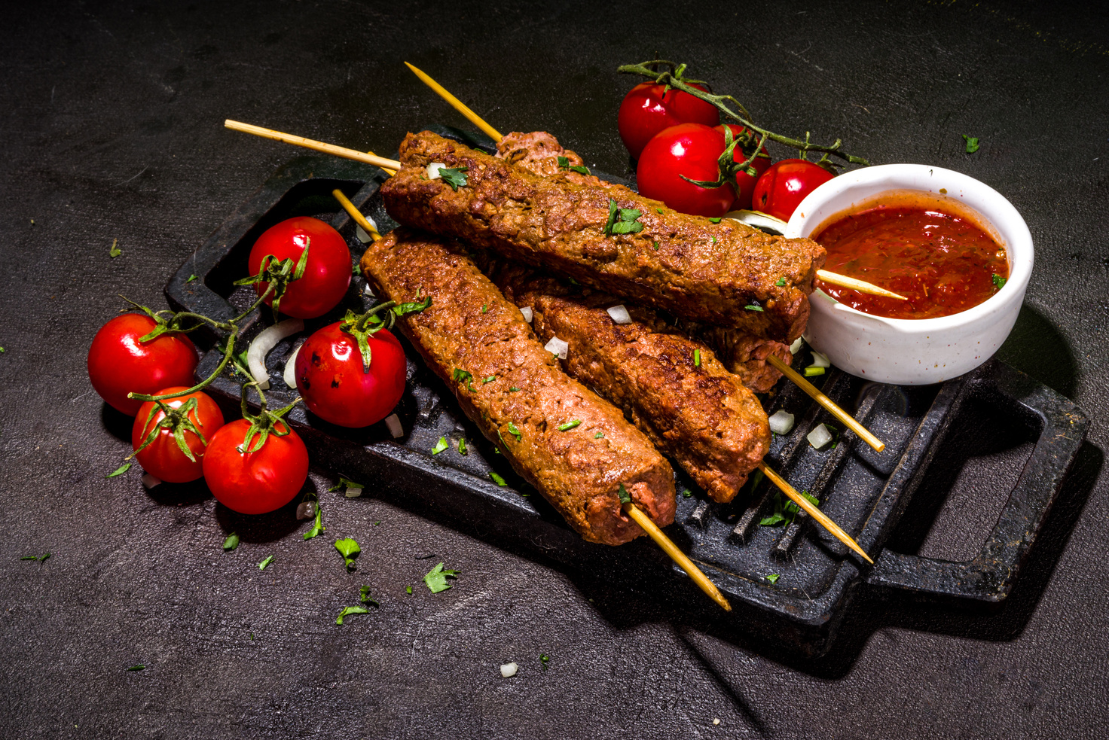
Ingredients
  2 medium chicken breasts
  1 small green pepper
  1 medium onion
  100g mushrooms (Optional)
  2 tablespoons of marinade e.g. BBQ, tikka, spicy (school will provide this)
  2 pitta breads
Please bring a suitable container with lid
Chicken & Vegetable Kebabs
Method
  1. Wash hands, tie hair back, put on an apron, tuck stools and bags under tables.
  2. Cut chicken breasts into 3cm cubes – if using a marinade, place into a bowl with sauce
  3. Chop pepper and onion into large chunks.
  4. Slice the mushroom in half.
  5. Taking colour into account, put chicken and vegetables onto a skewer. E.g., chicken, red pepper, onion, green pepper, chicken, mushroom, chicken
  6. Place one skewer under the grill, and turn every 3-4 mins
  7. Cut open pita bread and take ingredients from the cooked skewer and place inside
Cooking Date: ______________________________

Slide 10
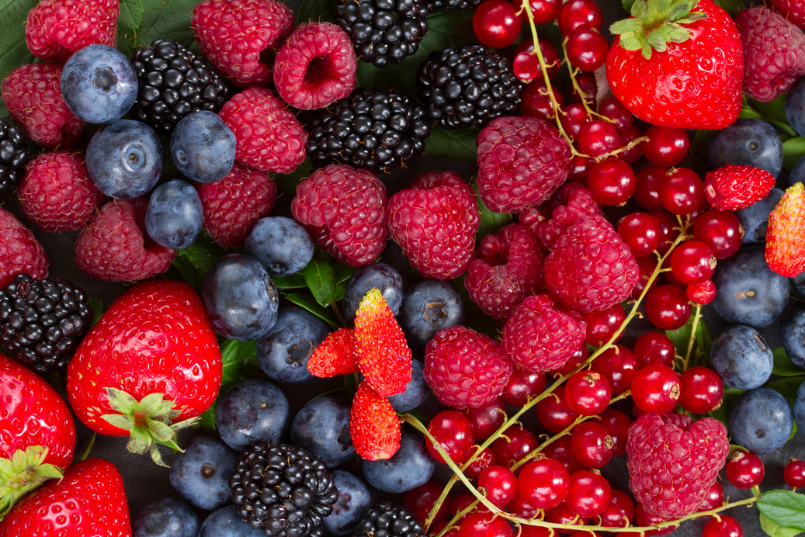
Ingredients
  150g Soft Margarine
  150g Caster Sugar
  3 eggs
  150g Self Raising Flour
  3 tablespoons of frozen mixed berries (the school will provide this)
  1 packet of white chocolate chips.
Summer Berry & Chocolate Tray Bake
Method
1. Preheat the oven to 1600C / Gas Mark 5
2. Cream the margarine and sugar until light and airy
3. Beat the egg into the mixture
4. Fold in the flour a spoonful at a time
5. Fold in the berries and white chocolate
6. Pour the mixture into a lined foil tray and cook for 20 mins until golden and springy to the touch.
Cooking Date: ______________________________

Slide 11
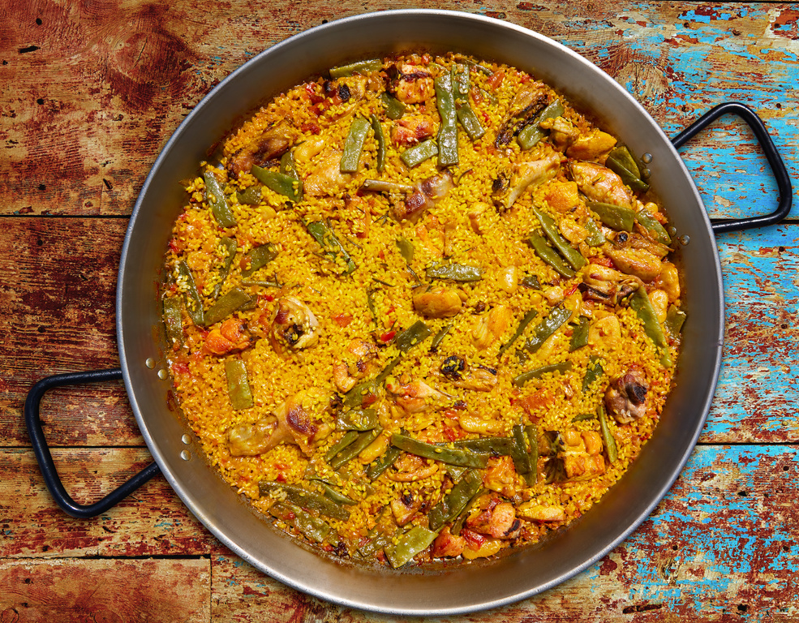
Ingredients
  150g of any long or short-grain rice
  1 tbsp oil (provided by the school)
  1 small onion
  1 clove of garlic
  1 Pepper (of any colour)
  1 cup of frozen peas (school will provide)
  1 tomato (Optional)
  1 tsp paprika (school will provide)
  1 chicken or vegetable stock cube
  ground black pepper (school will provide)
Please bring a suitable container with lid
Vegetable Paella
Method
1. Prepare and chop all your vegetables- keep the onions and garlic separate from the rest of the vegetables.
2. Heat the oil in a frying pan, add the onions and garlic, cover, and cook for about 3 minutes until soft. Then add the peppers and peas, stir in, cover again, and cook for a few more minutes.
3. Make a well in the centre, put the tomatoes in the well and the paprika on top. Then add the stock and season with pepper and stir.
4. Scatter as much of the rice as you think will fit over the stock, stir it in gently, then allow it to simmer gently until the liquid has absorbed and the rice is cooked. This could take about 20 minutes, stirring occasionally.
5. Test a bit of the rice to see if it's cooked, add a bit of stock or hot water if it is not done.
Cooking Date: ______________________________

