Slide 1



Ingredients
150ml milk
1 x small pot of fruit yogurt
1 banana
Choose 2 items or anything suitable from the list below:
4 large strawberries/a handful of blueberries/ a handful of grapes or one pear/kiwi (this could be frozen or canned)
Please bring in a suitable container or drinks bottle with a tight-fitting lid.
Fruit Smoothie
Method
1. Wash and chop up your fruit using a chopping board.
2. Add the chopped fruit to the blender
3. Pour into your container
4. Wash up all equipment in hot soapy water
Cooking Date: ______________________________

Slide 2
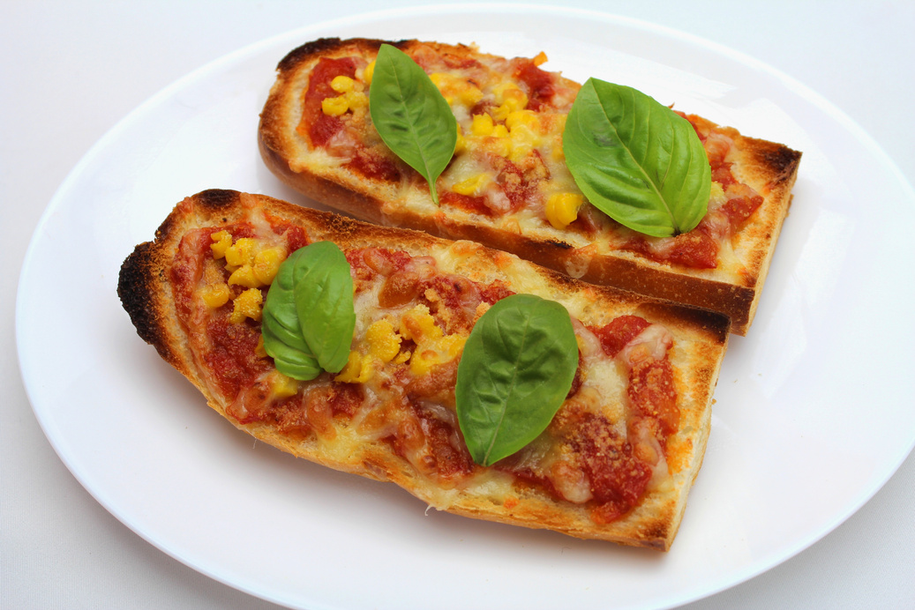
Ingredients
1/3 French stick
50g hard cheese e.g. cheddar, edam
Toppings (pick two from the list)
½ red or yellow pepper
½ an onion
2 mushrooms
50g sweetcorn
Pizza Toast
Method
1. Preheat the grill to 200°c.
2. Slice the pepper, spring onion or mushroom.
3. Grate the cheese.
4. Place the bread under the grill and toast the crust side.
5. Remove the bread from the grill.
6. Spread the tomato puree and chopped tomatoes over the
uncooked side of the bread using the back of the spoon.
7. Arrange the pepper, mushroom or onion over the bread
followed by the grated cheese.
8. Place under the grill until the cheese bubbles.
9. Cool and wrap in tin foil.
Cooking Date: ______________________________

Slide 3
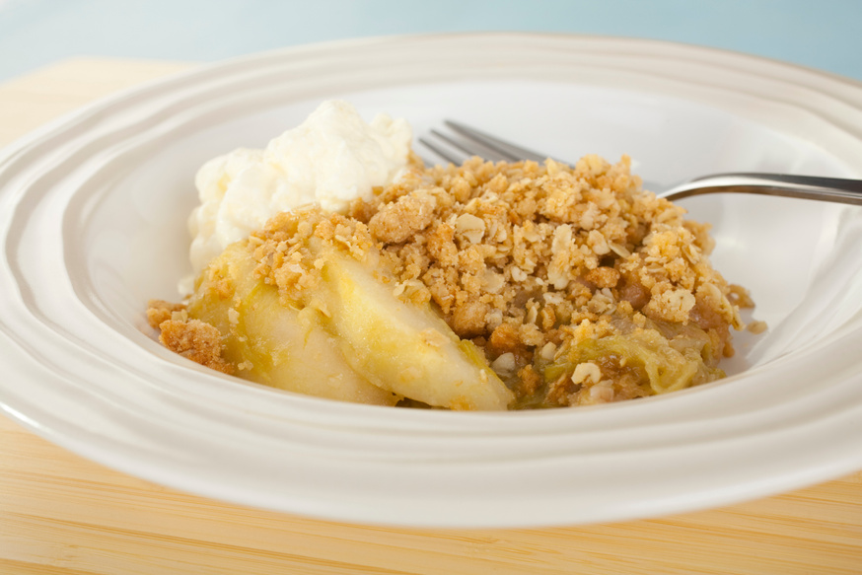
Ingredients
150g flour
50g oats (optional)
50g butter
2 x tablespoons of sugar
1 x can of apples or 2 x medium cooking apples
Handful of raisins or sultanas (optional)
Apple Crumble
Method - Crumble mixture:
1. Weigh 100g flour. Add to mixing bowl
2. Weigh 50g butter. Add to mixing bowl
3. Rub butter into flour (breadcrumbs)
4. Add 25g sugar. Mix
4. Add Oats. Mix
Method - Apple mixture:
1. Wash, core and slice apples finely
2. Cover the apples with just enough hot tap water. Add 1 teaspoon of sugar and heat gently for 7 minutes. Use oven gloves to take the pan off the heat and drain the water out of the pan.
3. Add 1 tablespoon of sultanas
4. Add the apples to the bottom of your own proof dish.
5. Add crumble mixture over the top of the apples.
6. Bake at 200 degrees C for 20 minutes
Cooking Date: ______________________________

Slide 4
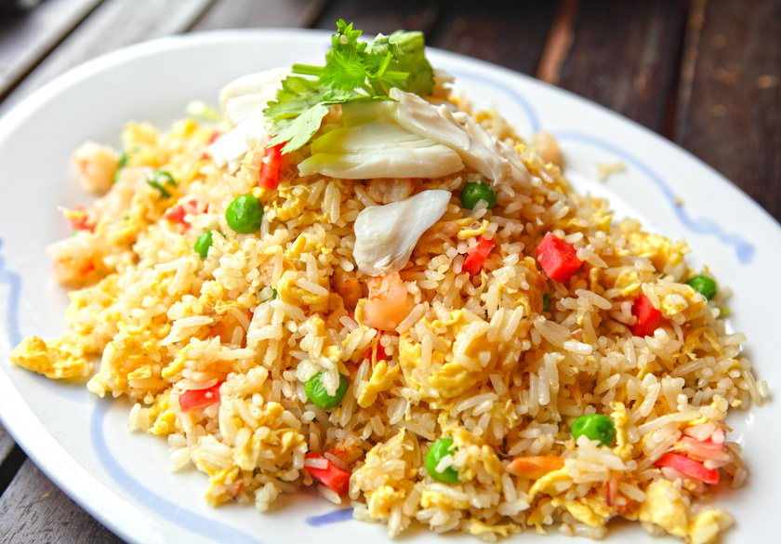
Ingredients
150g Rice
1 spring onion
1 Pepper of any colour
2 eggs
Pinch of salt
1 tsp soy sauce (supplied by school)
Please bring a suitable container with lid
Egg Fried Rice
Method
1. Boil the rice with hot water for 15 minutes.
2. Dice the peppers and chop up the spring onion.
3. Heat a frying pan over a high heat.
4. Add the oil, white spring onion and peas or sweet corn and stir for 40 seconds.
5. Beat the egg with the salt and add to the pan. Leave for 10 seconds until the egg sets on the bottom but remains runny on the top.
6. Add the rice and turn and mix continuously for 3 minutes until thoroughly hot.
7. Mix in the soy sauce add the peeper and mixed herbs.
8. Add the green spring onions and serve.
Cooking Date: ______________________________

Slide 5
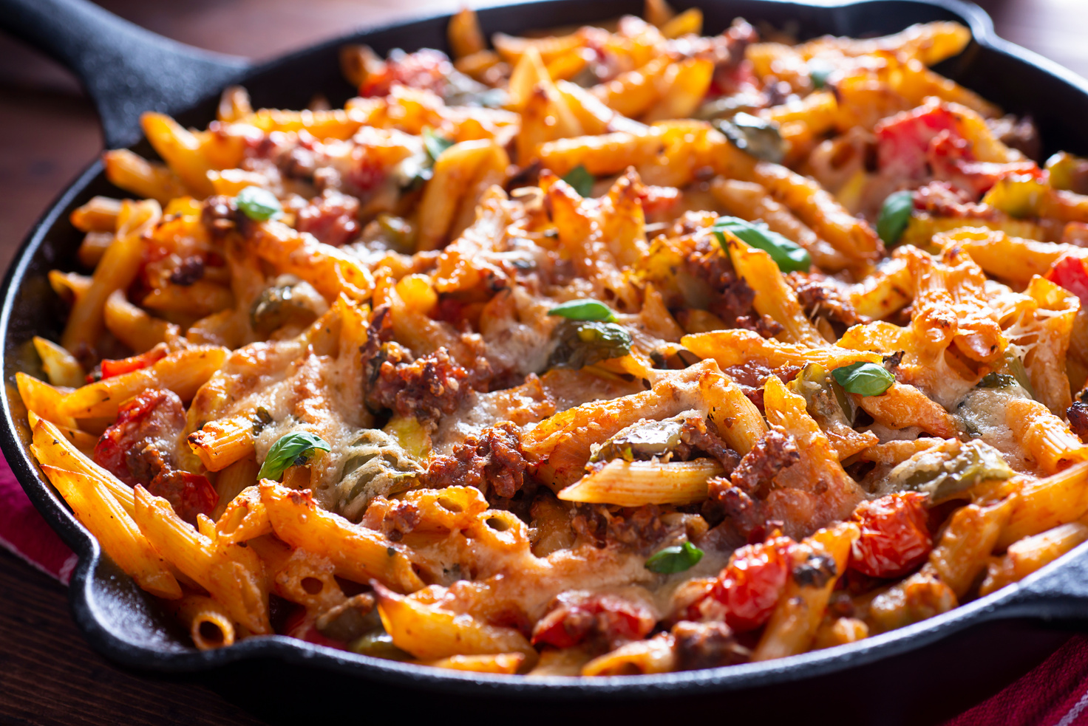
Ingredients
150g Dried Pasta
1 small onion
1 clove of garlic
1 can of chopped tomatoes
Choose one vegetable from the list below:
1 Pepper (any colour)
5 Mushrooms
2 tablespoons of sweetcorn
15g of grated cheddar cheese (optional)
Mixed Herbs or a handful of fresh basil
1 tablespoon of oil
A suitable container to go in the oven
20p for a foil tray (if you do not have an oven proof dish)
Vegetable Pasta
Bake
Method
1. Turn the oven on 200C / gas mark 6.
2. Fill a pan half full of water and put to boil. Add ¼ teaspoon salt.
3. Add the pasta shapes to the boiling water and cook for the time recommended on its packet.
4. Use a can opener to open the chopped tomatoes. Wash your mushrooms and drain in a colander.
5. On a chopping board chop your vegetables finely and peel and chop a clove of garlic.
6.Using a colander over the sink drain the cooked pasta..
7. Add 1 teaspoon of oil to a pan and allow to heat for 1 minute. Then add the chopped onion, and after 1 minute add the garlic.
8. Cook the onion until they all go see-through and start to turn brown.
9. Add your vegetables and cook for a further five minutes.
10. Add the drained cooked pasta to the tomato sauce season with a pinch of salt, pepper, and mixed herbs.
11. Leave to simmer for five minutes and then add the pasta to your container.
Cooking Date: ______________________________

Slide 6
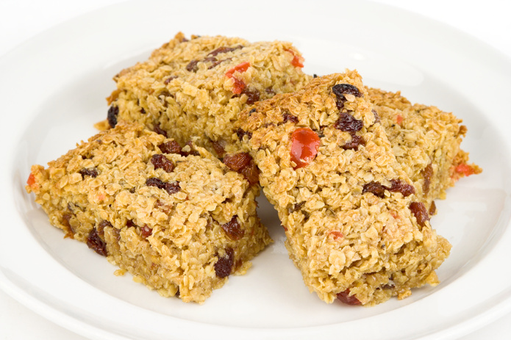
Ingredients
180g porridge oats
50g margarine
1 tablespoons syrup (the school will provide this)
2 heaped teaspoons of sugar
50g flavourings e.g., dried fruit, choc chips, coconut
A suitable container to go in the oven
20p for a foil tray (if you do not have an oven proof dish)
Flapjacks
Method
1. Preheat oven to 180 degrees C/ Gas 5
2. In a pan gently melt the margarine, syrup, and sugar over low heat, stirring with a wooden spoon.
3. Remove the saucepan from the heat and stir in the oats and any flavourings.
4. Tip the mixture into the foil tray and flatten with a fork.
5. Bake in the oven for approximately 15-20 minutes, cool for several minutes, before cutting the flapjacks into biscuit pieces.
Cooking Date: ______________________________

Slide 7
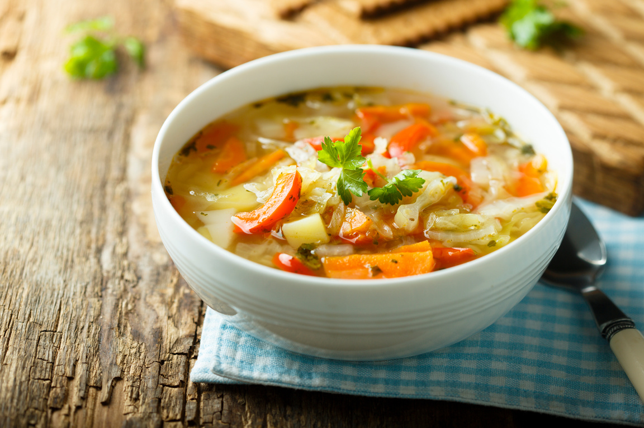
Ingredients
1 small onion
1 potato
1 carrot
1 tbsp oil
1 stock cube (beef/chicken or vegetable)
Salt and pepper to season (provided by the school)
Vegetable Soup
Method
1. Peel all the vegetables.
2. Grate the carrot and finely chop the other vegetables.
3. Fry all vegetables in the oil.
4. Add the water and stock cube and bring to a boil, simmer with the lid on for about 20 mins.
5. Blend the flour with 4 tbsp. water until smooth and add to the soup – simmer for another 5 mins.
6. Add salt and pepper to season the soup.
7. Blend until you have the texture you require.
8. Pour into container.
Cooking Date: ______________________________

Slide 8
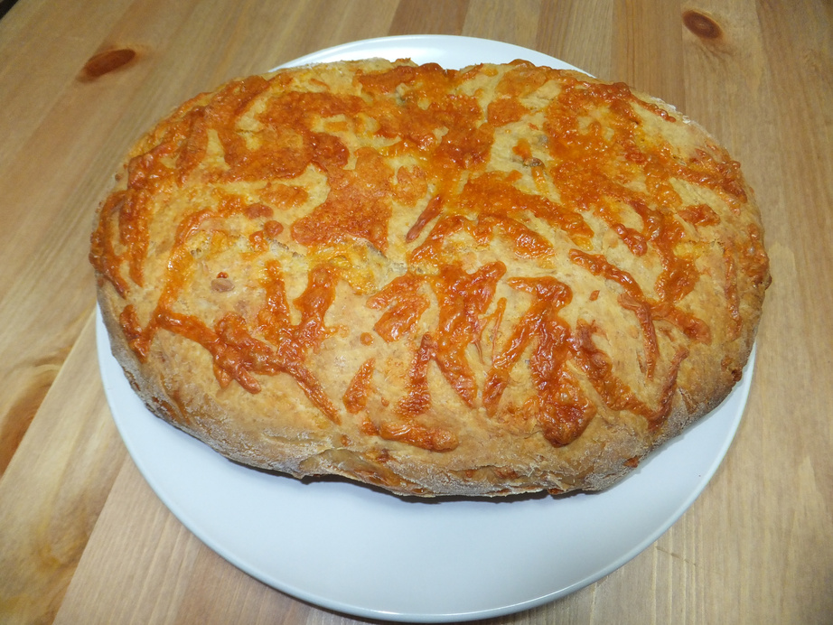
Ingredients
200g of Self raising flour.
Pinch of salt (the school will provide this item)
Pinch of mustard powder (the school will provide this item)
50g of margarine
75g of grated cheese
1 Egg
150ml of milk
Cheese Loaf
1.Pre heat the oven to Gas mark 6, 200 degrees Celsius.
2.Sieve the flour, salt, and mustard powder together.
3. Rub the margarine into this mixture.
4.Add the grated cheese to the flour.
5.Use a measuring jug to beat the egg and milk together. Keep aside a little of this mixture to glaze the loaf at the end.
6. Add the egg and milk mixture gradually to the flour, salt and mustard powder, to form a dough.
7.Shape the dough into a loaf shape put it in the greased tin.
8.Bake the loaf for about 30 minutes until it is well risen and golden in colour.
9.Place to cool on a wire tray.
10.Clean work surfaces and wash up equipment.
Method
Cooking Date: ______________________________

Slide 9
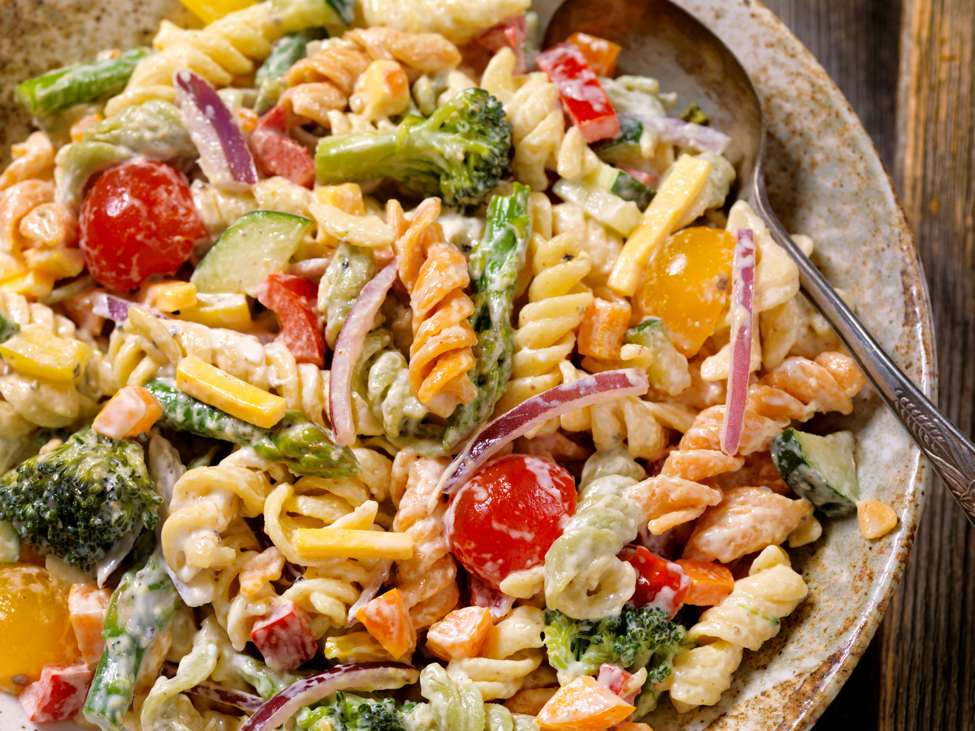

Ingredients
100g pasta shapes
Choose 3 vegetables only, you can select a Protein based food, this is optional.
Vegetables / Fruit
1 small red, green, or yellow pepper
1 Small red onion
Protein foods (optional) If you wish you can select one food from the list below
100g cooked ham
1 tin tuna
100g pre-grated cheese
100g cooked chicken
Pasta Salad
Method
1. Bring a small saucepan of water to the boil and add the pasta. Simmer for about 8-10 minutes (check the packet instructions).
2.Use a chopping bard and knife to carefully shred the lettuce.
3.Slice the tomato into four pieces.
4.Chop the cucumber into small chunks.
5.Peel and grate the carrot.
6.Drain the boiling hot water away from the pasta into a colander in the sink. Cool the pasta by rinsing it under a cold tap for a few moments. Drain well.
7. Place the pasta in the serving dish and stir in 1x15ml spoon of reduced-fat dressing.
Cooking Date: ______________________________

Slide 10
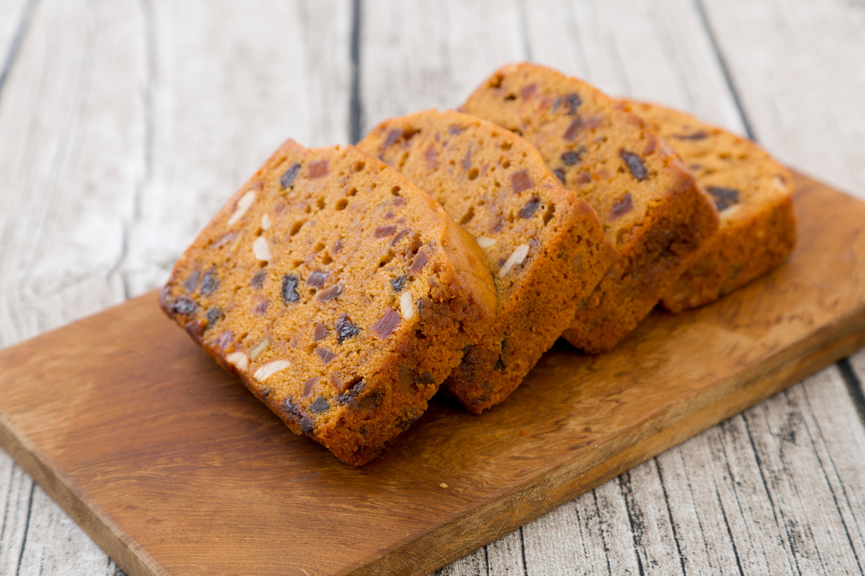
Ingredients
100g self-raising flour
100g caster sugar
100g butter or soft baking spread
2 eggs
50g dried fruit, e.g. sultanas
Paper Cake cases
Mini Fruit Cakes
Method
1. Preheat the oven to 200 degrees C or gas mark 6.
2. Place the cake cases in the patty tin.
3. Sift the flour into the mixing bowl and then add all the other ingredients.
4. Mix everything together until light and fluffy.
5. Stir in the dried fruit.
6. Divide the mixture equally between the cake cases using 2 spoons.
7. Bake for 15-20 minutes, until golden.
8. Allow the cakes to cool on a cooling rack.
Cooking Date: ______________________________

Slide 11
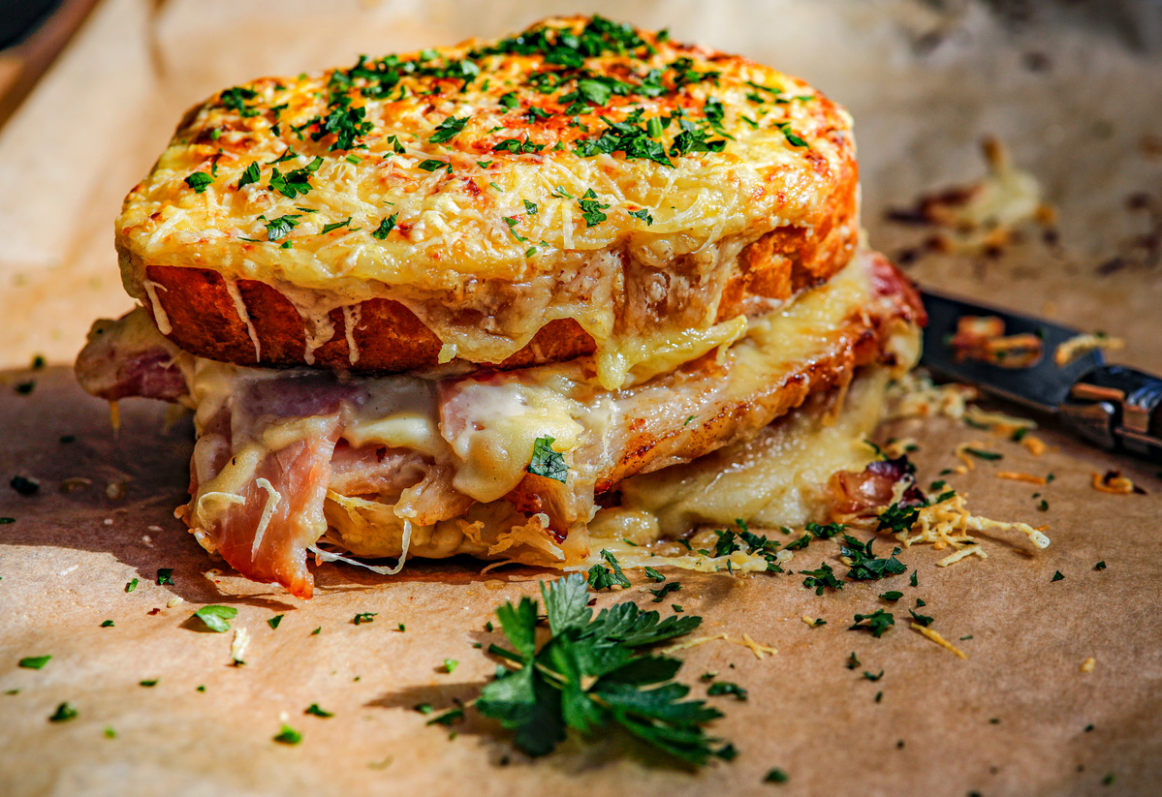
Ingredients
4 slices of bread
1 tomato
2 slices of Ham
25g of grated cheese
Please bring a suitable container with lid
Croque Monsieur
Method
1. Preheat the grill
2. Grate the cheese onto a chopping board using a cheese grater.
3. Toast one side of bread only until it is golden brown.
4. Whilst the breads are toasting, chop up the tomatoes on a chopping board.
5. Put the grilled bread onto a chopping board.
6. Turn the grilled slice of bread over and spread the mustard on the bread.
7. Add a slice of cheese ham tomato and cheese again
8. Spread some more of the sauce and place this side down on the cheese
9. Add the bechamel sauce in the middle and top with grated cheese.
Cooking Date: ______________________________

Slide 12
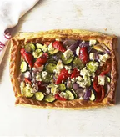
Ingredients
4 slices of bread
1 tomato
2 slices of Ham
25g of grated cheese
Please bring a suitable container with lid
Mediterranean Tart
Method
1. Roll out the puff pastry keeping it as square in shape as possible.
2. Use a table knife to score a line all the way around the edge, this should be about 2 cm from the edge.
3. Spread the tomato sauce on the bottom, keeping inside the scored lines.
4. Sprinkle on the cheese
5. Add the sliced toppings
6. Bake for 20- 25 minutes until the pastry is golden brown.
7. Use oven gloves to remove from the oven and leave to cool before covering in tin foil.
Cooking Date: ______________________________

Slide 13
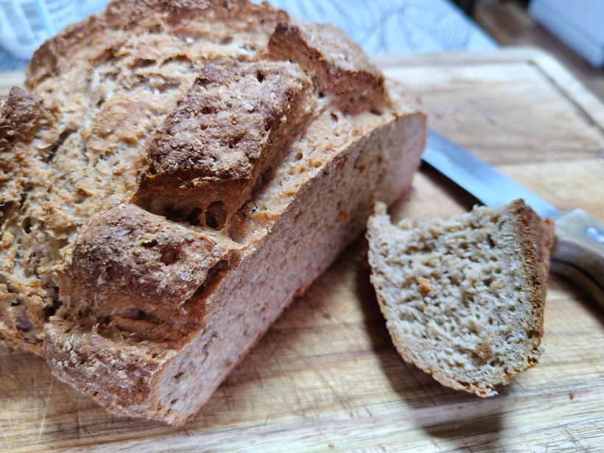
Ingredients
4 slices of bread
1 tomato
2 slices of Ham
25g of grated cheese
Please bring a suitable container with lid
Irish Soda Bread
Method
1. Preheat the oven to 400F/200C/Gas 6.
2. Tip the flour, salt and bicarbonate of soda into a large mixing bowl and stir.
3. Make a well in the centre and pour in the buttermilk, mixing quickly with a large fork to form a soft dough. (Depending upon the absorbency of the flour, you may need to add a little milk if the dough seems too stiff, but it should not be too wet or sticky.)
4. Turn onto a lightly floured surface and knead briefly.
5. Form into a round and flatten the dough slightly before placing on a lightly floured baking sheet.
6. Cut a cross on the top and bake for about 30 minutes or until the loaf sounds hollow when tapped.
7. Cool on a wire rack.
Cooking Date: ______________________________

