Slide 1
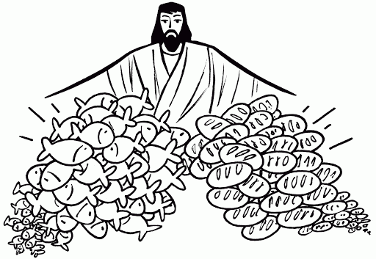
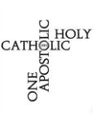
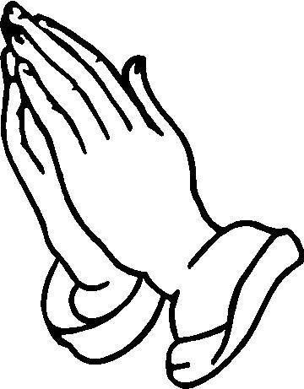
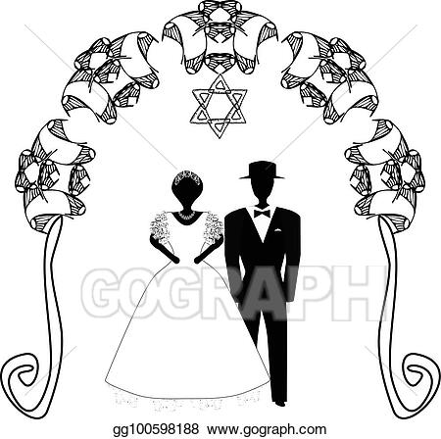
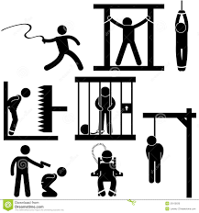
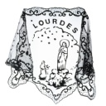
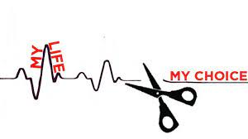
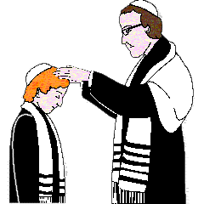
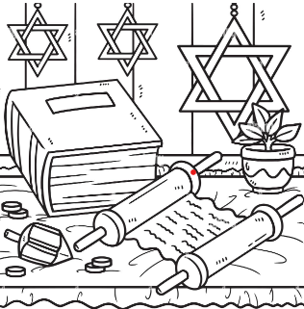
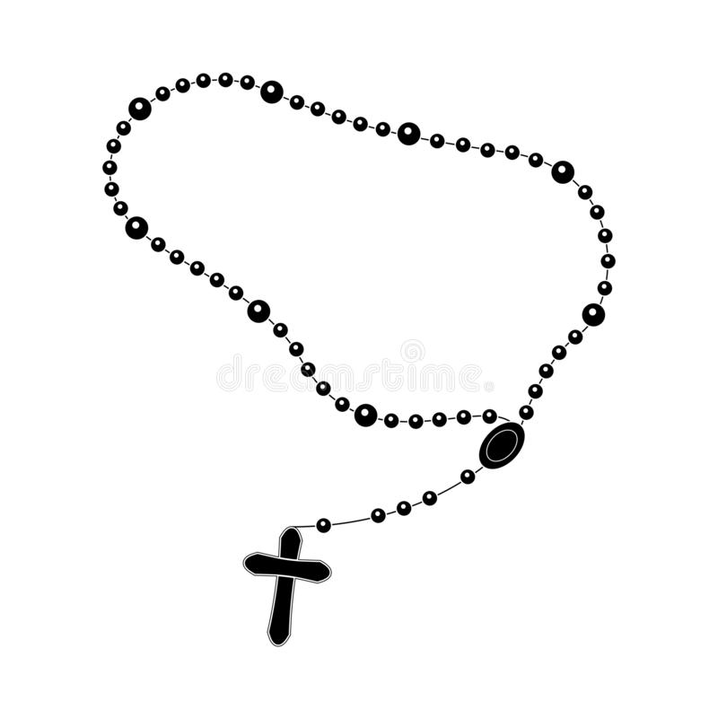
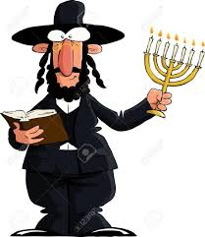
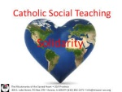
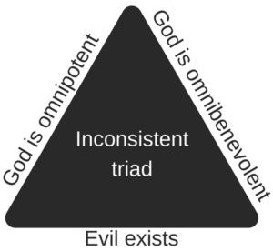
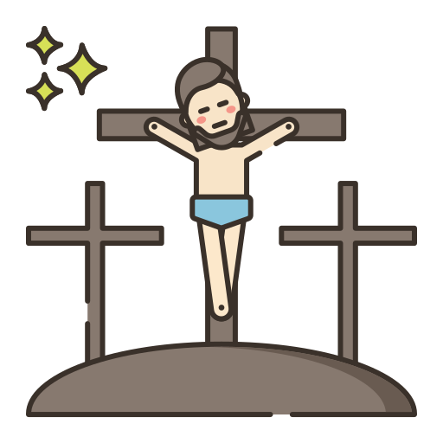
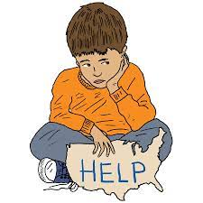
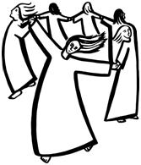
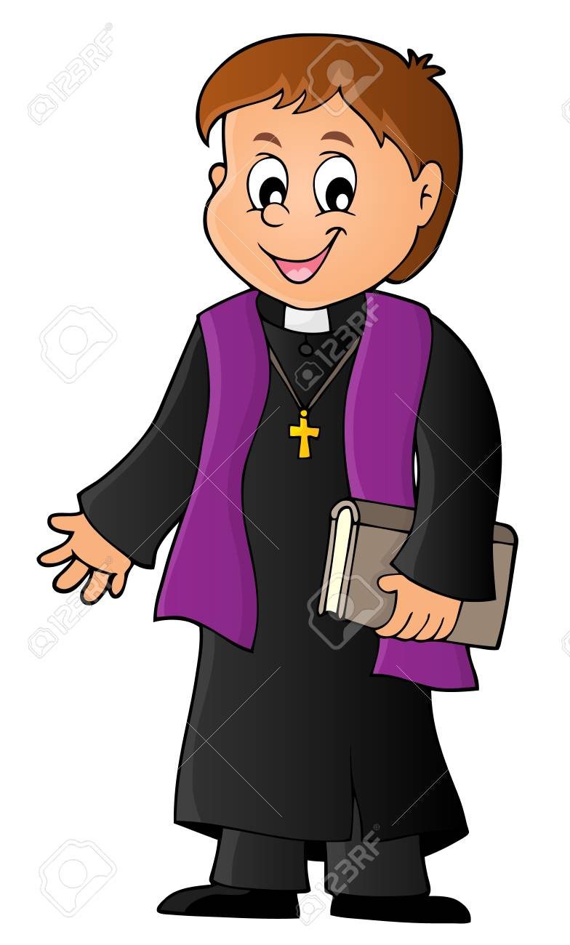
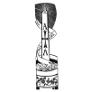
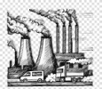
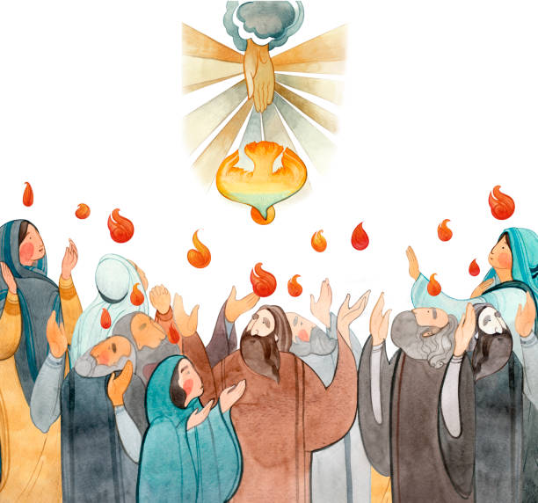
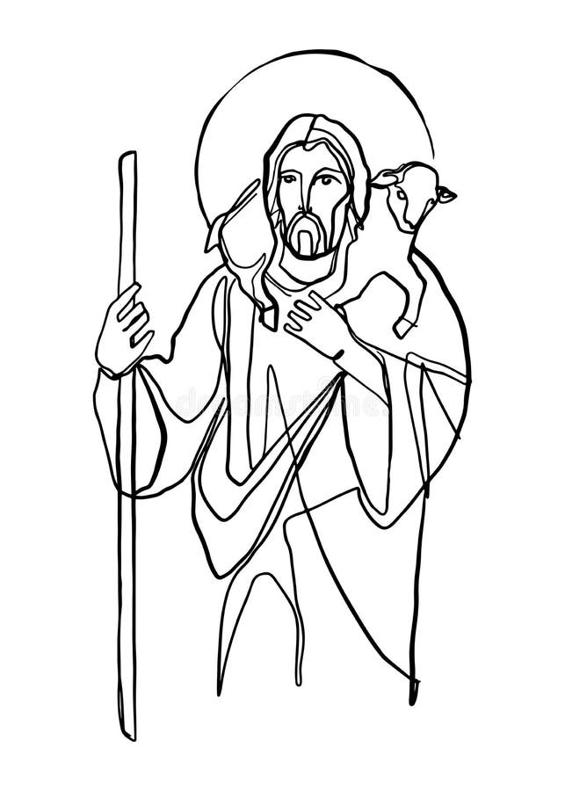
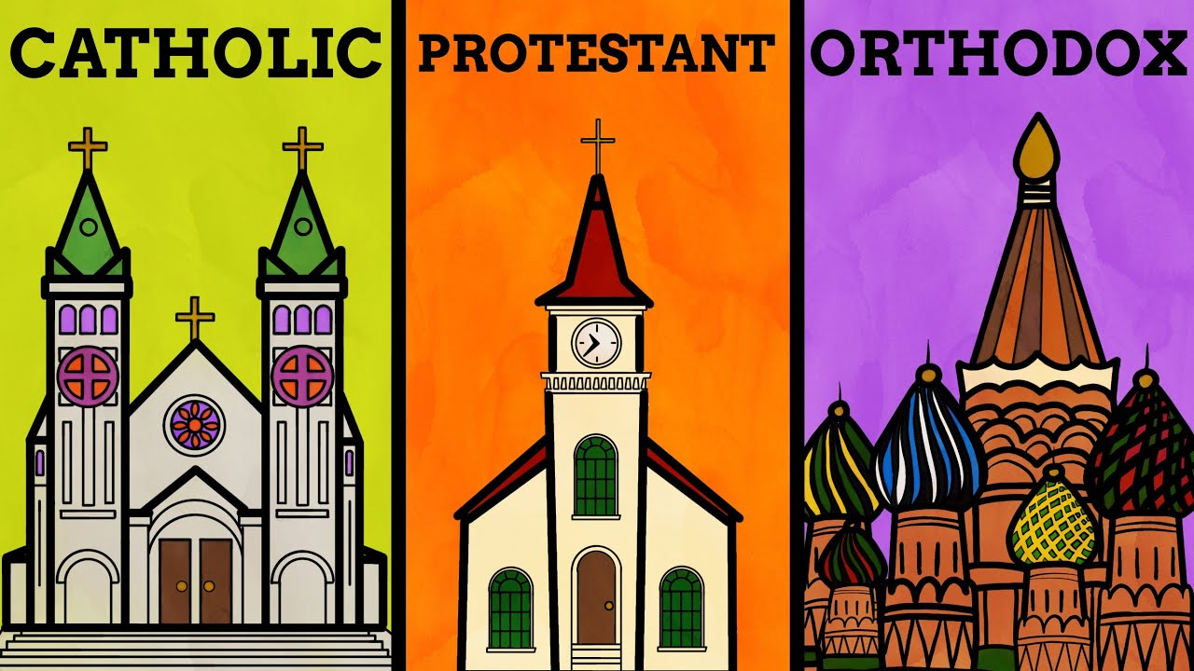
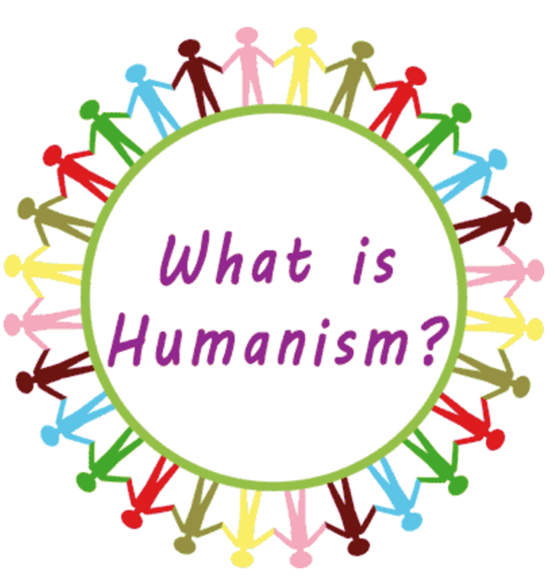
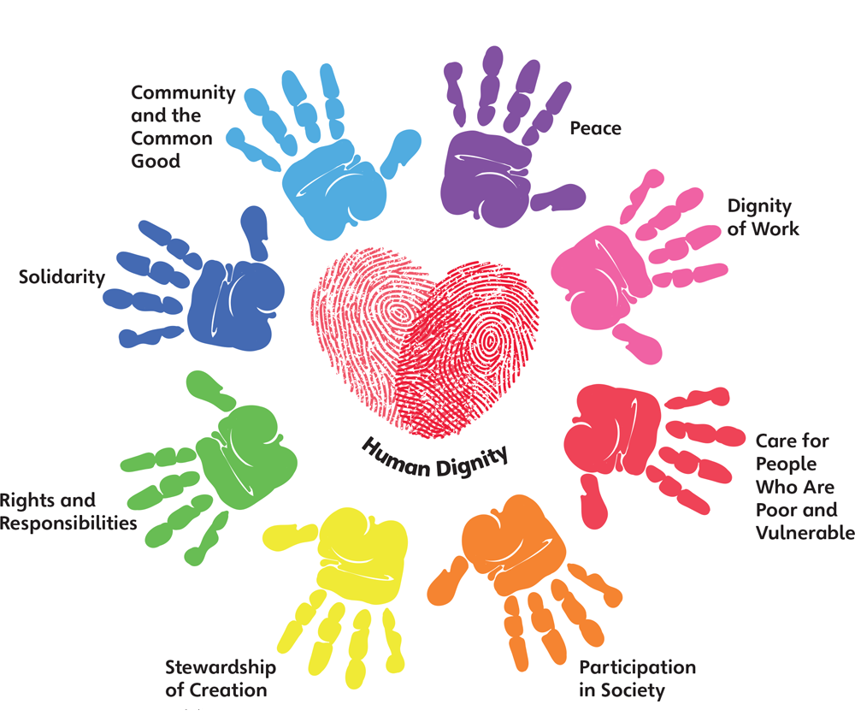
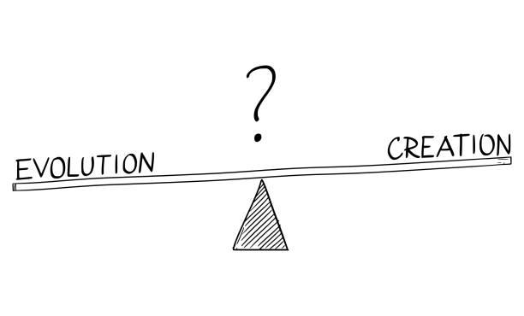
Religious Studies
My Learning journey
DEFINE- Definition of a key term
DESCRIBE- Demonstrate knowledge and understanding
by describing a belief, teaching, practice, event
Yer 11
Skills
EXPLAIN- Demonstrate knowledge and understanding of a
belief/value with reasoning and/or evidence.
DISCUSS- Demonstrate analysis and
evaluation of a topic by discussing a variety of
different arguments with reasoning, key terms
and evidence.
The Sacraments
What are Religious Experiences?
Features of a Church
JUDAISM
REVISION
Exam & Post – 16
Destination
SIN AND FORGIVNESS
What is Revelation?
Visions
The four marks of the Church
Redemption
Reconciliation and Forgiveness
Prayer
Religious symbols
Architecture of a Church
YEAR
The significance of the Paschal Mystery
11
SIN AND FORGIVENESS
Eschatology and The Funeral Rite
Mary as a model of the Church
The Body of Christ
Capital Punishment
Aims of Punishment
Vatican II
LIFE AND DEATH
The Magisterium
Jewish Festivals
Attitudes to Abortion
The Bible
What is Incarnation?
The Trinity
Attitudes to Euthanasia
Sanctity of Life
Rituals
YEAR
Artwork
Pilgrimage
DIALOGUE AND ENCOUNTER: Judaism
10
ORIGINS AND MEANING
GOOD AND EVIL
Popular Piety
Jewish Worship
The Messiah
Creation
The Problem of Evil
The Covenants
Catholic social teaching
Creation and
the Nature of God and Humanity
Attitudes to Stewardship
The Beauty of suffering
Moral authority
The Mitzvot
The Shekinah
Jewish Holy Books
The Almighty
What is Poverty?
Supporting family life
Divorce & remarriage
Attitudes to Abortion
The Causation Argument
Judaism and Poverty
Child Poverty
Marriage
The Design Argument
BELIEF IN GOD
Miracles
HUMAN RIGHTS
PEACE AND CONFLICT
FAITH AND MEDICAL ISSUES
HUMAN DIGNITY
Sexual relationships
Catholicism and Poverty
Imago Dei
Creation of humans Genesis 1 and 2
YEAR
9
What do the prophets teach us?
Jesus and the marginalised
What is the Trinity?
What is stewardship?
What are the 5 pillars?
What is the problem of Islamophobia?
The greatest commandment
Conscience
Advent
What are the Sacraments?
Why should we care for the world?
DIALOGUE & ENCOUNTER: Islam
Original sin and Free will
CREATION AND COVENANT
PROPHECY AND PROMISE
GALILEE TO
JERUSALEM
DESERT TO
GARDEN
TO THE ENDS OF
THE EARTH
YEAR
How is Jihad misunderstood?
8
Baptism
Modern day prophets
What is faith in action?
The Bible
What do Catholics believe about God?
What is the creation story?
How do we damage the earth?
How do Muslims worship?
The Role of a Priest
What is
prayer?
What is the
Paschal mystery?
Different Christian Denominations
The Holy Spirit and Pentecost
The Sacraments
The Paschal Mystery
The Incarnation
Scripture and
the Mass
The Magisterium
The Role of Prayer
Genesis Creation Stories and God
DIALOGUE AND ENCOUNTER
Who is Jesus?
YEAR
TO THE ENDS OF
THE EARTH
DESERT TO
GARDEN
GALILEE TO
JERUSALEM
PROPHECY AND
PROMISE
CREATION AND
COVENANT
7
SIKHISM
Confirmation
The Trinity
Living with the Spirit
Different Eucharistic Beliefs
The Eucharist
Living as Jesus Taught
How is Scripture Inspired?
The Bible
Science and Creation
Human Responsibility
#TeamSPH #HeadHeartHandsTogetheronthesuccessjourney

